Slide 1
UNDERSTANDING ANTIRESORPTIVE THERAPY IN CANCER

Slide 2
Outline
Section 1 : Anatomy & Physiology
Bone Anatomy
Vitamin D3 and Calcium
Bone Remodeling
Bone Signaling & RANKL
Section 2 : Pathophysiology
Functions of bone
Molecular Composition
Cancer & Bone
Cancer Type
Risk Factor in bone development
Osteoporosis
Screening of Osteoporosis : DEXA & T Score
Cancer and Osteoporosis
Section 3: Treatment Options
Difference Between Anabolic Vs Antiresorptive Agents
Treatment for Osteoporosis
Medications
MAB’s
OUTLINE
Section 4: Rx Information
Description & Key Facts
Indications
Contraindications
Warning and precautions
Adverse Reaction
Section 5: Guidelines & Recommendations
Section 7: Clinical Overview
MOA : Denosumab
MOA: Denosumab Vs Bisphosphonates
Dosage & Administration
PK/PD
Use in Specific population
Over Dosage
Key differences : bisphosphonates Vs Denosumab
Section 8 : FAQ

Slide 3
Section 1: Anatomy & Physiology

Slide 4
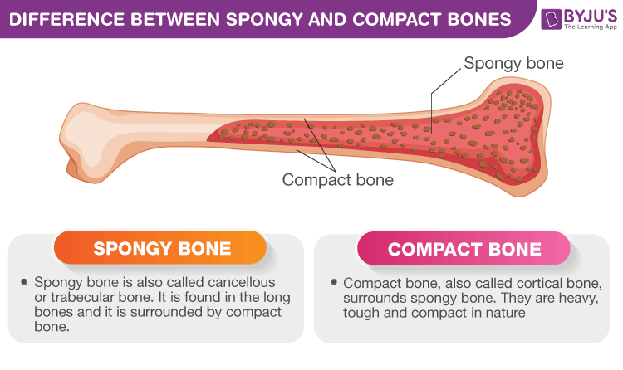
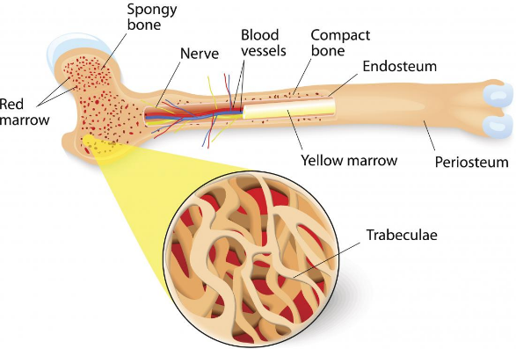
Bone Anatomy
Bones are composed of two types of tissue:
Compact (cortical) bone:
Cancellous (trabecular or spongy) bone:
A hard outer layer that is dense, strong, and durable.
This consists of a network of trabeculae or rod-like structures.
Makes up around 80 % of adult bone mass.
lighter, less dense, and more flexible than compact bone

Slide 5
Function of Bones
Support | Bones provide a framework that supports the body and cradles its soft organs.
Protection | The fused bones of the skill protect the brain. The vertebrae surround the spinal cord, and the rib cage protects the vital organs of the thorax.
Anchorage | Skeletal muscles, which attach to the bones by tendons, use bones as levers to move the body and its parts.
Blood Cell Formation | Most blood cell formation, or haematopoiesis, occurs in the red marrow cavities of certain bones.
Allows Mineral and Growth factor storage | Bone is a reservoir for minerals, most importantly calcium and phosphate. Stored minerals are released into the bloodstream in their ionic form as needed for distribution to all parts of the body.
Triglyceride (Fat) storage | Fat, a source of energy for the body, is stored in bone cavities.
Hormone production | Bones produce osteocalcin, a hormone that helps to regulate insulin secretion, glucose homeostasis, and energy expenditure.
https://quizlet.com/148364378/seven-important-functions-of-bones-flash-cards/

Slide 6
Molecular Composition of Bone
Bone
Cells
Osteoblast
Osteoclast
Osteocyte
Matrix
Organic Compounds
Collagen
Non Collagenous
Inorganic Compounds
Calcium
Phosphate
Carbonate
Sodium
Magnesium
Potassium
Osteopontin
Osteonectin
Bone Sialoprotein
Osteocalcin
Proteoglycans
(67%)
(33%)
(28%-30%)
(5%-7%)
(39%) (17%) (9.8%) (0.7%) (0.5%) (0.2%)

Slide 7
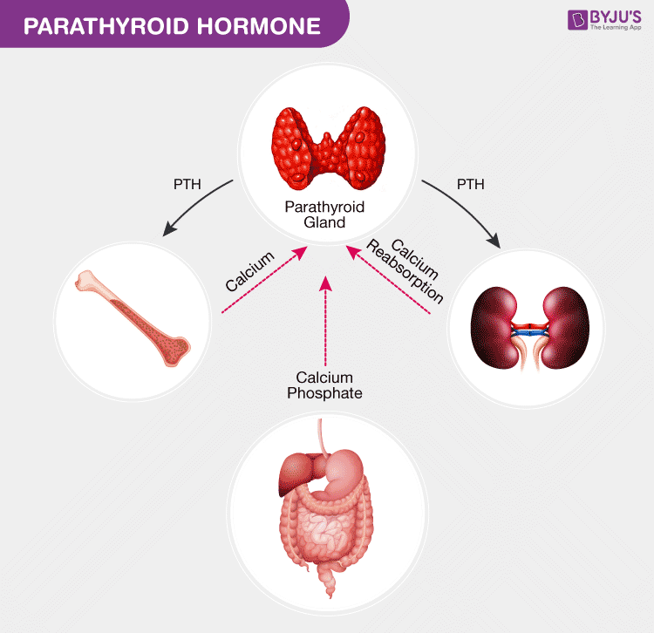
Parathyroid Hormone PTH
PTH Causes
Bones to release Calcium in Blood stream (Increase Osteoclast)
increases the calcium absorption in the intestine by food through its impacts and affects the metabolism of vitamin D
Minimizes the calcium loss in the urine and also stimulates active vitamin D formation in the kidneys.
Vit D3 Activation

Slide 8
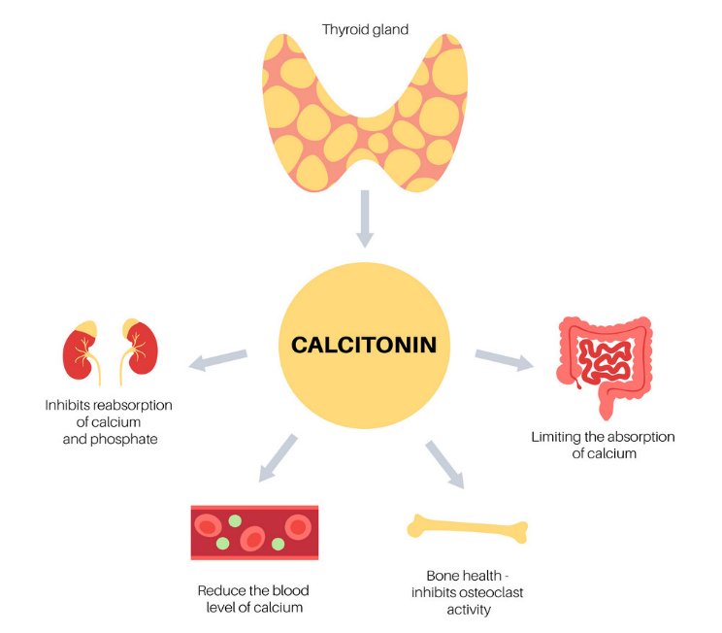
Calcitonin Causes
Bones to inhibit osteoclast Activity
Decrease in Intestinal Absorption of calcium
Inhibits reabsorption of calcium and phosphate
Reduce overall blood calcium level

Slide 9
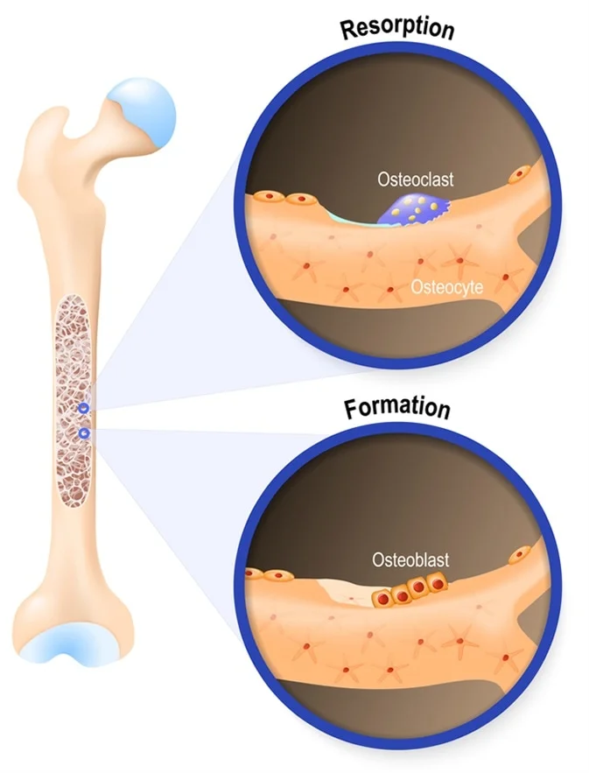
Bone Metabolism
Osteoclast
Bone metabolism is a dynamic process that balances bone formation and bone resorption
Bone Resorption
Performed by Active Osteoclast and Stimulated by RANKL (Normal Process)
Stimulated by PTH in pathologic process
(Metastatic disease)
Bone Formation
Stimulating osteoblasts and Inhibiting osteoclasts
Osteoblast
https://www.orthobullets.com/basic-science/9010/bone-signaling-and-rankl

Slide 10
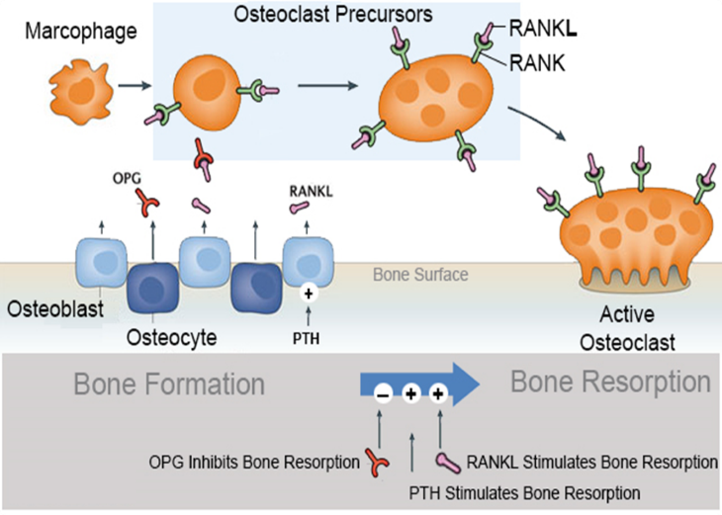
Bone Signaling & RANKL
Osteoblast Produces RANKL and OPG.
RANKL Binds to RANK on Stimulates Osteoclastic bone resorption
This is called Osteoclast activation or Active Osteoclast
OPG Inhibits Osteoclast process
Osteoclast Inhibition decreases bone resorption
Leads to increase in Bone formation
RANKL: Receptor activator of nuclear factor kappa-Β ligand (protein)
OPG: osteoprotegerin (regulatory Factor)
https://www.orthobullets.com/basic-science/9010/bone-signaling-and-rankl

Slide 11
Osteoclast Activation & Inhibition.
OSTEOCLAST ACTIVATION
OSTEOCLAST INHIBITION
Molecules that stimulate bone resorption
RANKL
PTH
interleukin 1 (IL-1)
1,25 dihydroxy vitamin D
prostaglandin E2
IL-6 (myeloma)
MIP-1A (myeloma)
Molecules that inhibit bone resorption
Oosteoprotegerin (OPG)
Calcitonin
Estrogen
Inhibits activation of adenylyl cyclase
transforming growth factor beta (TGF beta)
Interleukin 10 (IL-10)
https://www.orthobullets.com/basic-science/9010/bone-signaling-and-rankl

Slide 12
Summary
Bone Anatomy: Compact _ Hard & Spongy_ Porous
Function: Support, Protection, Anchorage, Blood Cell Formation, Blood Cell Formation, Allows Mineral and Growth factor storage, Triglyceride (Fat) storage, Hormone production
Bone Composition: Cells _Osteoblast, Osteoclast, Osteocytes / Matrix _ Calcium (39%)
PTH: ↑ Ca release from bone, ↑ Calcium Reabsorption in Intestine, ↓ Calcium loss In Urine & vit D3 Activation
Calcitonin: Opposite of PTH

Slide 13
Summary
Bone Remodelling: Osteoclast: Bone Resorption or Dissolving _ Osteoblast: Bone Formation.
Bone Signalling & RANKL: RankL _↑Osteoclastic Activation_ OPG_ ↑Osteoblastic inactivation

Slide 14
Section 2: Pathophysiology

Slide 15
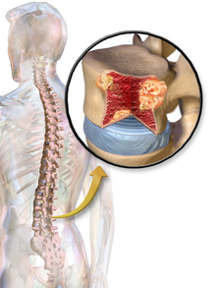
Cancer and Bone
Individuals may be at risk for serious bone problems if diagnosed with
Breast,
Prostate, or
Other types of solid tumours (cancer) with bone metastases

Slide 16




What Are Serious Bone Problems That Can Arise?
When your bones are weakened by cancer, you are at risk for serious bone problems, which are:
A need for radiation treatments to the bone
Pressure on the spinal cord (compression)
Broken bones (fractures)
A need for bone surgery

Slide 17

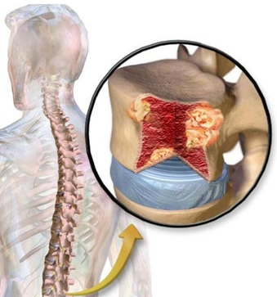
Terminologies :
Solid Tumors:
An abnormal mass of tissue that usually does not contain cysts or liquid areas.
Solid tumors may be benign (not cancer), or malignant (cancer)
Multiple myeloma :
A cancer that forms in a type of white blood cell called a plasma cell
Bone pain often is the first symptom people

Slide 18
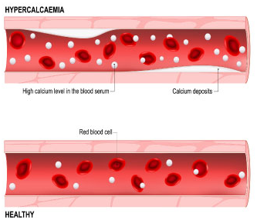
Terminologies :
Hypercalcemia of malignancy (HCM) :
An abnormally high level of calcium in the blood common in advanced cancer
it is often caused by excessive osteoclast-mediated bone resorption.
Patients may not respond to or may relapse after iv bisphosphonate therapy.

Slide 19
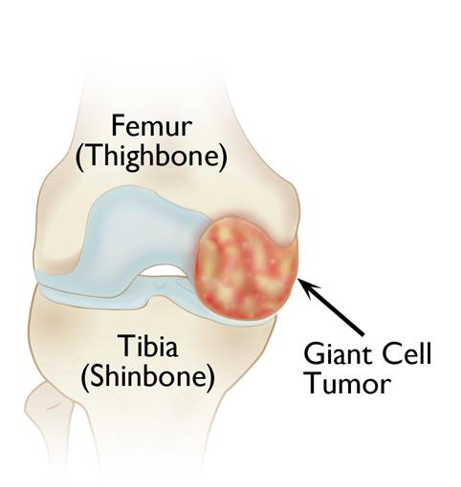
Terminologies :
Giant Cell Tumor Of The Bone:
Giant cell tumor of bone is a rare, aggressive non-cancerous tumor.
Happens in adults between ages 20 and 40 when skeletal bone growth is complete.
It usually develops near a joint at the end of the bone.

Slide 20

How do bone metastases from SOLID TUMORS lead to bone complications?
How do bone lesions in MULTIPLE MYELOMA lead to bone complications?

Slide 21
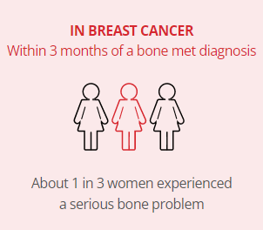
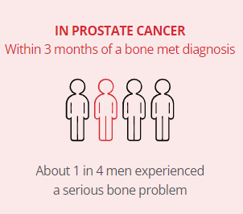
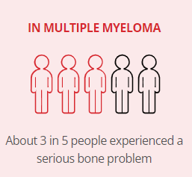
Cancer and Bone Prevalence
*BONE COMPLICATIONS: Also known as skeletal-related events (SREs), are defined as Radiation To Bone, Pathologic Fracture, Surgery To Bone, Radiation To Bone, Spinal Cord Compression And Hypercalcemia Of Malignancy ¹
SOLID TUMOR
MULTIPLE MYELOMA
1. J Bone Oncol. 2013;2(4):137-144.
https://www.Denosumab.com/why-bones-matter

Slide 22
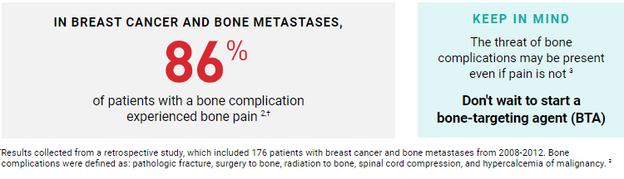
Signs & Symptoms
Bone complications are strongly associated with pain
2. J Bone Oncol. 2013;2(4):137-144.
3. Urology. 2010;76(5):1175-1181

Slide 23
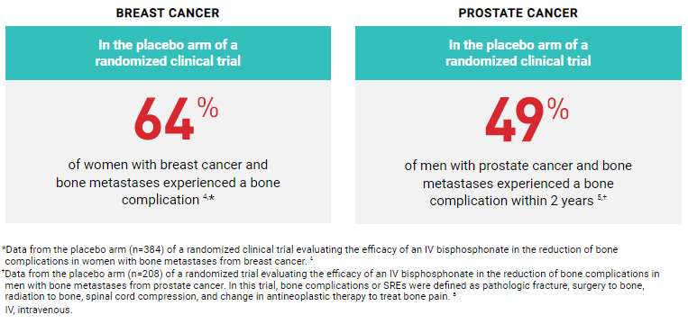
Risk In Solid Tumors
People with bone metastases from solid tumors are at risk of suffering one or more bone complications
4. Cancer. 2000;88(5):1082-1090.
5. J Natl Cancer Inst. 2004;96:879-882.

Slide 24
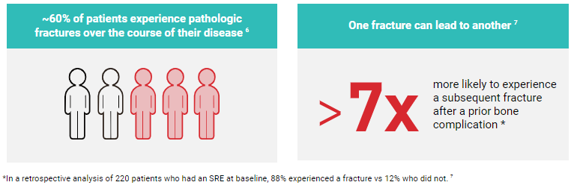
Risk In Multiple Myeloma
Multiple myeloma puts patients’ bones at risk for bone complications, which continues throughout the course of disease
6. J Bone Miner Res. 2005;20(3):487-493.
7. Cancer. 2007;110(8):1860-1867.

Slide 25
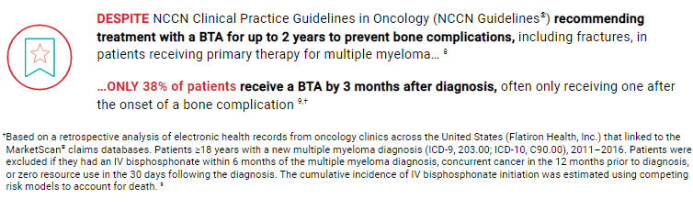
Risk In Multiple Myeloma Contd…
8. Referenced from NCCN Guidelines for Multiple Myeloma V.7.2021
9. Blood. 2017;130(Suppl 1):534.

Slide 26
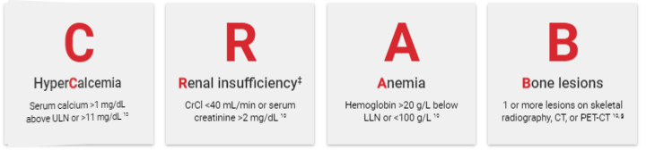
Bone disease is an important diagnostic feature of multiple myeloma ¹⁰
19%
of Patients ¹¹
∼40%
of Patients ¹²
39%
of Patients ¹²
∼70%
of Patients ^{13,14}
Bone lesions are the most prevalent CRAB feature present at diagnosis ^{13,14}
10. Lancet Oncol. 2014;15(12):e538-e548.
11. Br J Haematol. 2016;175(2):252-264.
12. Eur J Haematol. 1994;53(4):207-212.
13. Mayo Clin Proc. 2003;78(1):21-33
14. Lancet Oncol. 2018;19(3):370-381.
‡Multiple myeloma directly harms the kidneys, potentially complicating bone-targeting treatment for patients with renal impairment. ^{12,14}
§F-fluorodeoxyglucose PET with CT.
CrCl, creatinine clearance; CT, computed tomography; LLN, lower limit of normal; PET, positron emission tomography; ULN, upper limit of normal.

Slide 27
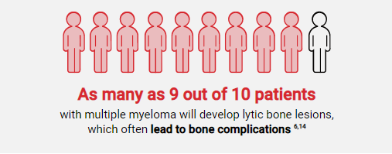
Multiple Myeloma & Lytic bone Lesions
6. J Bone Miner Res. 2005;20(3):487-493.
14. Lancet Oncol. 2018;19(3):370-381.

Slide 28
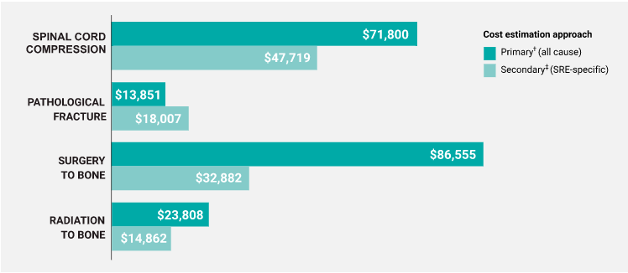
Cost Implications
BONE COMPLICATIONS CAN BE COSTLY
Average cost of bone complications in patients with commercial insurance ^{16,*}
16. Data on file, Amgen; 2021.

Slide 29
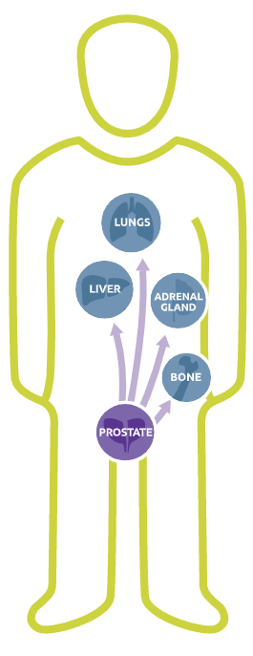
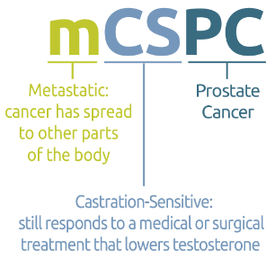
Types Of Prostate Cancer
What is mCSPC?
Prostate cancer that HAS SPREAD to other parts of the body and STILL responds to a medical or surgical treatment that lowers testosterone.
This is called metastatic castration-sensitive prostate cancer or mCSPC.
What is HRPC ?
prostate cancer that is NO LONGER RESPONDS to any type of hormone therapy, including the newer medicines.

Slide 30


Types Of Prostate Cancer
What is mCRPC?
Prostate cancer that HAS SPREAD to other parts of the body and NO LONGER responds to a medical or surgical treatment that lowers testosterone.
This is called non-metastatic castration-resistant prostate cancer or nmCRPC.
What is nmCRPC?
Prostate cancer that HAS NOT SPREAD to other parts of the body and NO LONGER responds to a medical or surgical treatment that lowers testosterone.
This is called non-metastatic castration-resistant prostate cancer or nmCRPC.
https://www.ncbi.nlm.nih.gov/pmc/articles/PMC5378096/

Slide 31
How does ADT put men with nonmetastatic prostate cancer at high risk for fracture?
Among Men with Nonmetastatic Prostate Cancer
Androgen deprivation therapy(ADT) can result in bone loss and is associated with fracture risk.^{3,4}
3. J Natl Compr Canc Netw. 2013;11(Suppl 3):S1–S50
4.J Clin Endocrinol Metab. 2005;90:6410-6417
3. Gralow JR, Biermann JS, Farooki A, et al. NCCN task force report: bone health in cancer care. J Natl Compr Canc Netw. 2013;11(Suppl 3):S1–S50. 4. Greenspan SL, Coates P, Sereika SM, Nelson JB, Trump DL, Resnick NM. Bone loss after initiation of androgen deprivation therapy in patients with prostate cancer. J Clin Endocrinol Metab. 2005;90:6410-6417

Slide 32
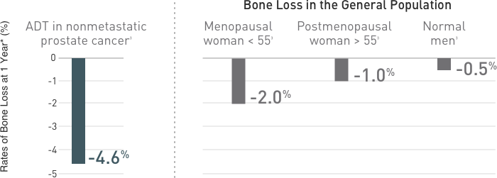
Prostate Cancer: Bone Mineral Density (BMD): Comparison of ADT-induced BMD loss vs normal BMD loss in men and women^{3,4}
4.J Clin Endocrinol Metab. 2005;90:6410-6417
Patients with prostate cancer receiving ADT lost up to 4% BMD at the posteroanterior spine in the first year of therapy alone.⁴
Calcium and vitamin D supplementation alone may not be sufficient to prevent bone loss and fractures in patients receiving ADT.⁸
Reference data are obtained from population-based or review articles that measured bone loss at different sites (eg, lumbar spine or total hip).3,8
3Gralow JR, Biermann JS, Farooki A, et al. NCCN task force report: bone health in cancer care. J Natl Compr Canc Netw. 2013;11(Suppl 3):S1–S50.
4. Greenspan SL, Coates P, Sereika SM, Nelson JB, Trump DL, Resnick NM. Bone loss after initiation of androgen deprivation therapy in patients with prostate cancer. J Clin Endocrinol Metab. 2005;90:6410-6417
8. Higano CS. Androgen-deprivation-therapy-induced fractures in men with nonmetastatic prostate cancer: what do we really know? Nat Clin Pract Urol. 2008;5:24-34

Slide 33
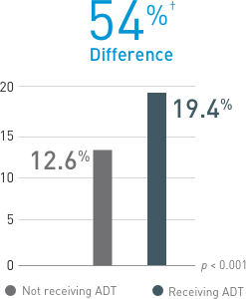
Prostate Cancer: Fracture: Percent of patients with a fracture, 12 to 60 months after diagnosis of prostate cancer
STUDY: SEER & MEDICARE DATA BASE : Data from a bone-related toxic effect sub analysis (n=26,685)
Men diagnosis of prostate cancer over a 12- to 60-month period.
ADT included gonadotropin-releasing hormone (GnRH) agonist therapy or orchiectomy.⁹
Data have shown that nearly 1 in 5 men receiving multiple doses of ADT experienced a fracture within 4 years after the first year of diagnosis.⁹
Patients with prostate cancer receiving ADT experienced a 54% increase in relative incidence of fractures compared with patients not receiving ADT.⁹
Calcium and vitamin D supplementation alone may not be sufficient to prevent bone loss and fractures in patients receiving ADT.⁸
9. N Engl J Med. 2005;352:154-164
8. Nat Clin Pract Urol. 2008;5:24-34
9. N Engl J Med. 2005;352:154-164

Slide 34
How does AI therapy put women with breast cancer at high risk for fracture?
Among Women with Breast Cancer
Aromatase inhibitor therapy results in estrogen depletion, leading to bone loss and increased fracture risk.^{3,4}
3. Lancet. 2015;386(9992):433-443.
3. Gralow JR, Biermann JS, Farooki A, et al. NCCN task force report: bone health in cancer care. J Natl Compr Canc Netw. 2013;11(Suppl 3):S1–S50. 4. Greenspan SL, Coates P, Sereika SM, Nelson JB, Trump DL, Resnick NM. Bone loss after initiation of androgen deprivation therapy in patients with prostate cancer. J Clin Endocrinol Metab. 2005;90:6410-6417

Slide 35
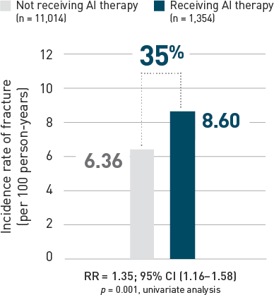
Breast Cancer: Fracture: Patients with breast cancer receiving (AI) therapy are more likely to experience a fracture than those not receiving aromatase inhibitor
Data from a claims-based retrospective cohort study conducted from 1998 to 2005, involving patients with breast cancer, without bone metastases, and no previous osteoporosis, osteopenia, or fracture claims, receiving AI therapy (n = 1,354) versus those not receiving AI therapy (n = 11,014).¹
Prevalence of bone Fracture : 8.6% in the AI group versus 6.36% in the control group,
Patients with Breast cancer receiving AI experienced a 35 % increase in relative incidence of fractures compared with patients not receiving AI.
Calcium and vitamin D supplementation alone may not be sufficient to prevent bone loss and fractures in patients receiving AI.
Clin Breast Cancer. 2006;7:127-132

Slide 36
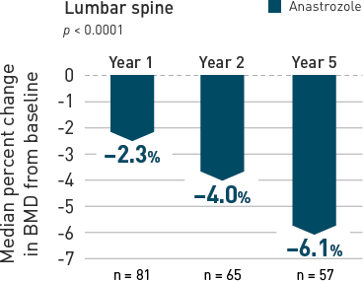
Breast Cancer: How does AI therapy put women with breast cancer at high risk for fracture?
Data from a randomized, double-blind, multicentre, prospective sub study performed within the ATAC (Arimidex, Tamoxifen, Alone or in Combination) trial assessing BMD changes at the lumbar spine and total hip in postmenopausal women with nonmetastatic breast cancer receiving anastrozole or tamoxifen therapy.^{1,2}
BMD: The most pronounced rate of bone loss at the lumbar spine, measured by BMD, occurs within the first year of AI therapy (-2.3%)
Calcium and vitamin D supplementation alone may not be sufficient to prevent bone loss and fractures in patients receiving AI.
1. J Clin Oncol. 2008;26:1051-1058
2. J Bone Miner Res. 2006;21:1215-1223

Slide 37
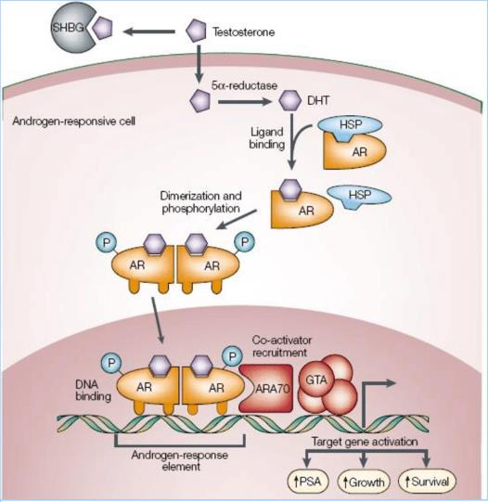
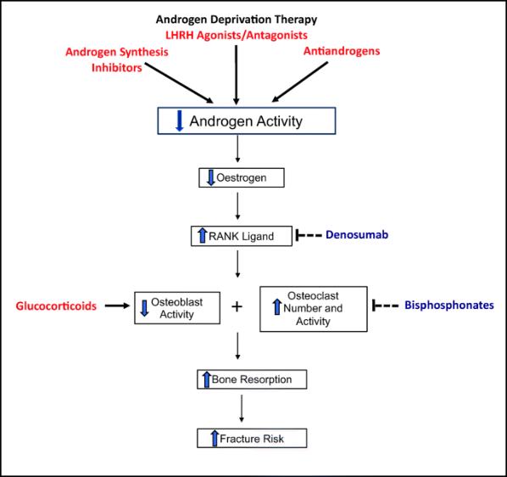
Prostate Cancer Treatment /AI Treatment & Osteoporosis
ADT INCREASES RISK OF BONE FRACTURE AND DECREASE BONE MINERAL DENSITY

Slide 38
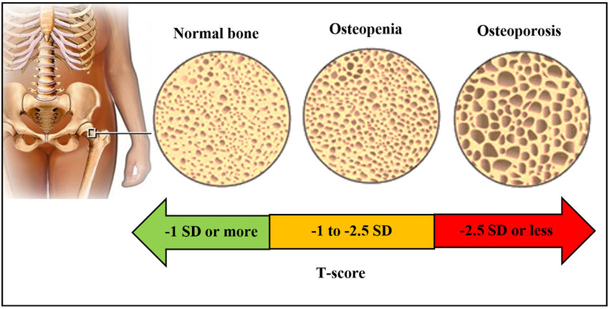
Osteoporosis
A condition in which bones become weak and brittle.
The body constantly absorbs and replaces bone tissue.
With osteoporosis, new bone creation doesn't keep up with old bone removal.

Slide 39
Summary:
Cancer & Bone: Serious bone problems if diagnosed with Breast, Prostate, or Other types of solid tumours (cancer) with bone metastases.
Solid Tumors: An abnormal mass of tissue that usually does not contain cysts or liquid areas
Multiple myeloma : A cancer that forms in a type of white blood cell called a plasma cell
Hypercalcemia of malignancy (HCM) : An abnormally high level of calcium in the blood common in advanced cancer
Giant Cell Tumor Of The Bone: A rare, aggressive non-cancerous tumor.

Slide 40
Summary
Bone Complications: Also known as skeletal-related events (SREs), are defined as Radiation To Bone, Pathologic Fracture, Surgery To Bone, Radiation To Bone, Spinal Cord Compression And Hypercalcemia Of Malignancy
Bone complications are strongly associated with pain_86% Patient with pain (Breast & prostate CA)
Multiple myeloma puts patients’ bones at risk for bone complications, which continues throughout the course of disease_60% Experience Pathologic fracture & >7X subsequent Fracture.

Slide 41
Summary
Only 38% of patients receive a BTA by 3 Months after Diagnosis even after recommendation to use BTA for 2 years
CRAB: Multiple Myeloma Diagnostic Feature
9 out of 10 develops lytic bone lesion with Multiple Myeloma
Treatment of Bone Complication is Costly
Types Of prostate Cancer : mCSPC, HRPC, mCRPC & nmCRPC
Osteoporosis: A condition in which bones become weak and brittle.

Slide 42
Section 3: Treatment Option

Slide 43
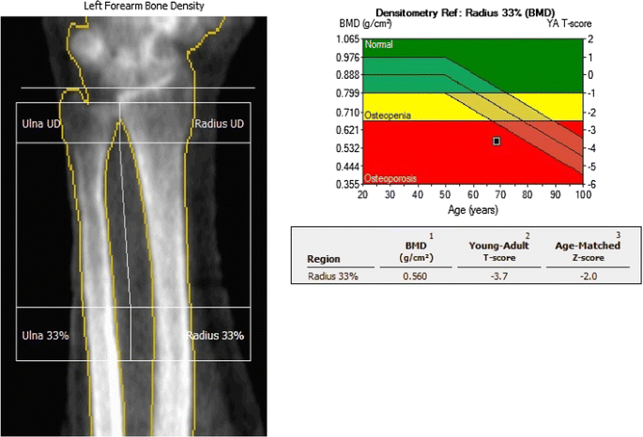
Osteoporosis Screening: DEXA Scan Dual-Energy X-ray Absorptiometry
A bone density scan which can detect thinning bones at an early stage.
DEXA scores are reported as "T-scores" and "Z-scores.“
Multiplying the T-score by 10% gives a rough estimate of how much bone density has been lost.
Z-scores are not used to formally diagnose osteoporosis
https://www.webmd.com/osteoporosis/features/tests

Slide 44
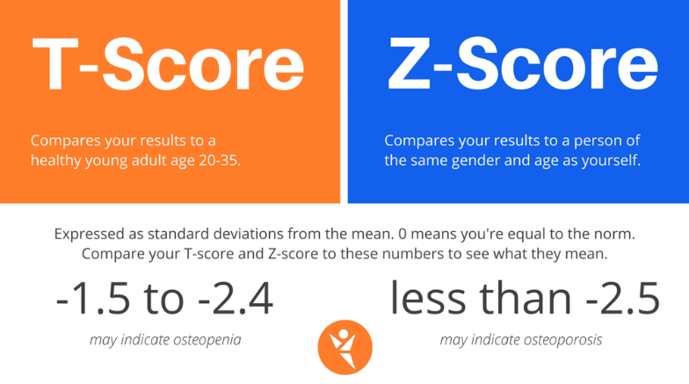
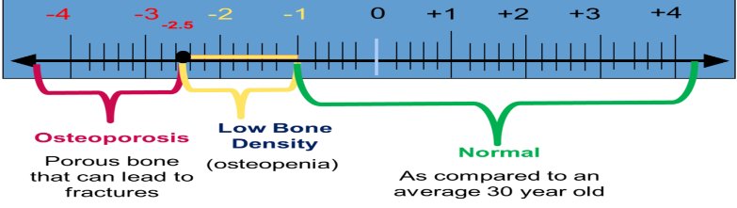
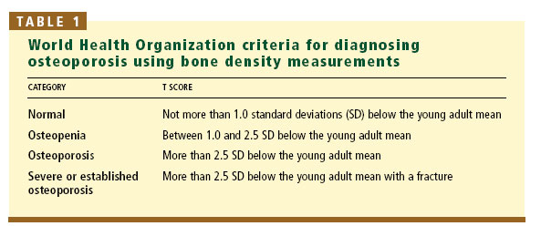
UNDERSTANDING T- SCORE The T-score is a comparison of a person's bone density with that of a healthy 30-year-old of the same sex. The Z-score is a comparison of a person's bone density with that of an average person of the same age and sex

Slide 45
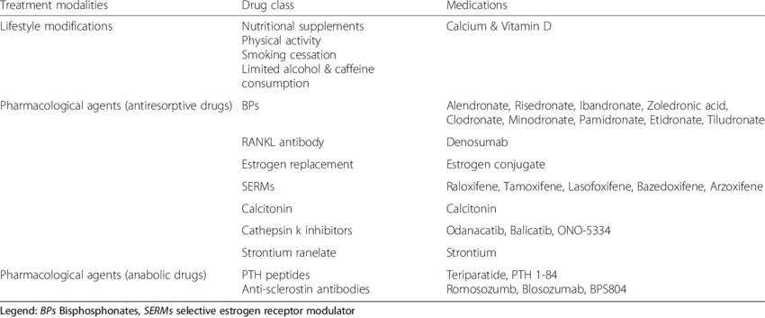
Treatment of Osteoporosis

Slide 46
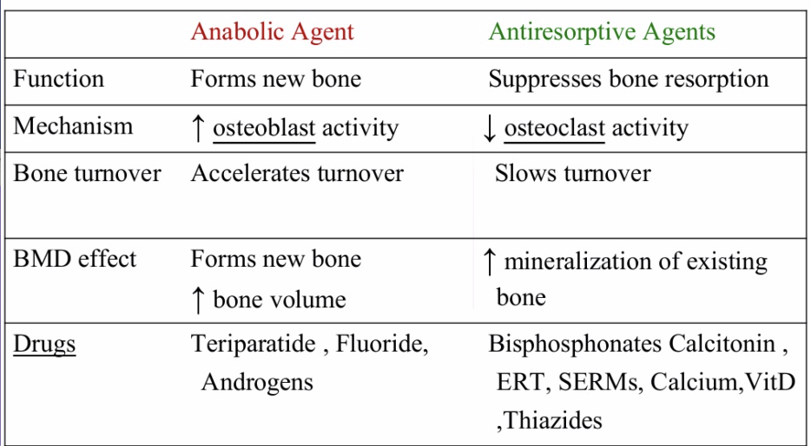
Difference Between Anabolic Vs Antiresorptive Agents

Slide 47
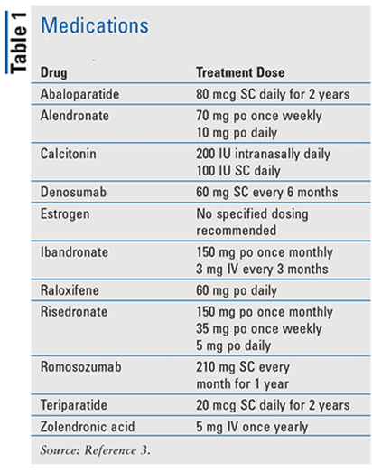
Medication for osteoporosis
BP : Zoledronic acid
Denosumab
Teriparatide
Romosozumab

Slide 48
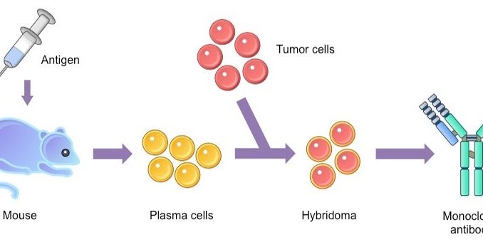
Monoclonal Antibodies
Monoclonal antibodies (also called moAbs or mAbs) are proteins made in laboratories that act like proteins called antibodies in our bodies.
Antibodies are parts of your immune system.
They seek out the antigens (foreign materials) and stick to them in order to destroy them.

Slide 49
Monoclonal Antibodies
Laboratory-made monoclonal antibodies help stimulate your own immune system.
The word “monoclonal” refers to the fact that the antibodies created in the laboratory are clones.
They are exact copies of one antibody.
Denosumab is a fully human monoclonal antibody
https://youtu.be/dxnjAc-rqz8

Slide 50
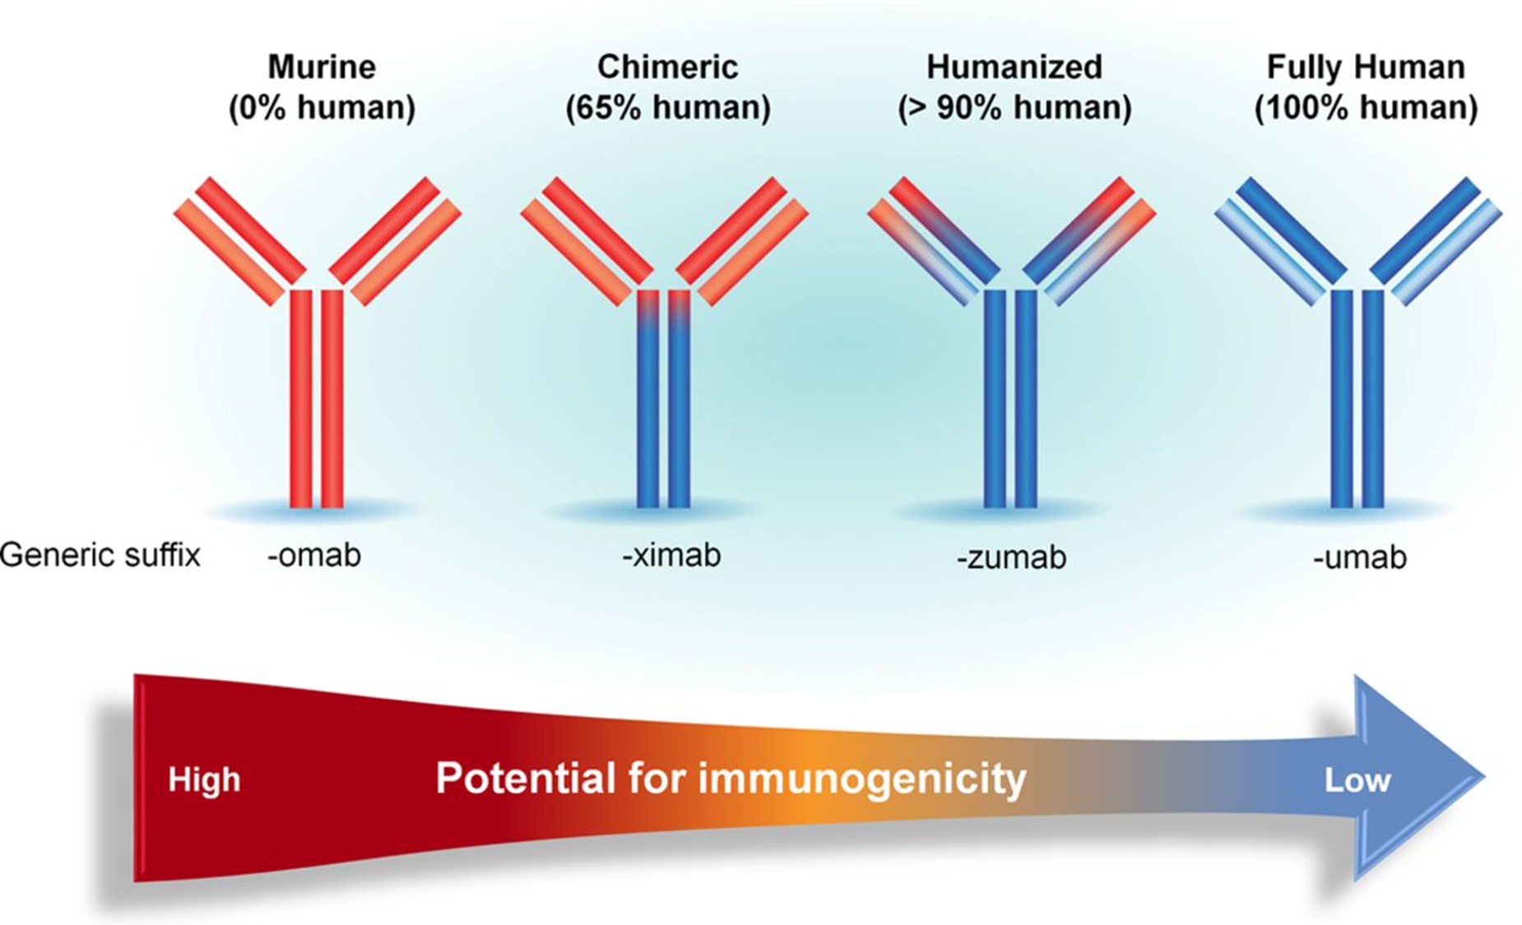
DENSOUMAB

Slide 51
Section 4: Prescription Information

Slide 52
Key Facts
MAB:
1st MAB Approved for treatment of Osteoporosis
MOA:
RANKLi (receptor activator of nuclear factor kappa-Β ligand)
CLASS: Bone anti-resorptive drug
Denosumab is not chemotherapy Drug
DOSAGE:
60 mg/mL every 6th Month.
120 mg every 4 wk subcutaneous injection

Slide 53
Approved Indication
Jun 1, 2010
Sep 19, 2011
Sep 21, 2012
May 21, 2018
Nov 19, 2010
Jun 13, 2013
Dec 8, 2014
Jan 5, 2018
For treatment of postmenopausal women with osteoporosis at high risk for fracture
Treatment of bone loss in patients with prostate or breast cancer undergoing ADT or AI Treatment
For the treatment of bone loss in men with osteoporosis at high risk for fracture
For glucocorticoid-induced osteoporosis
Prevention of skeletal-related events in patients with bone metastases from solid tumor
To treat giant cell tumor of the bone
Hypercalcemia of malignancy refractory to bisphosphonate therapy
For the prevention of skeletal-related events in patients with multiple myeloma
C
C
C
C
C
Referred from USFDA

Slide 54
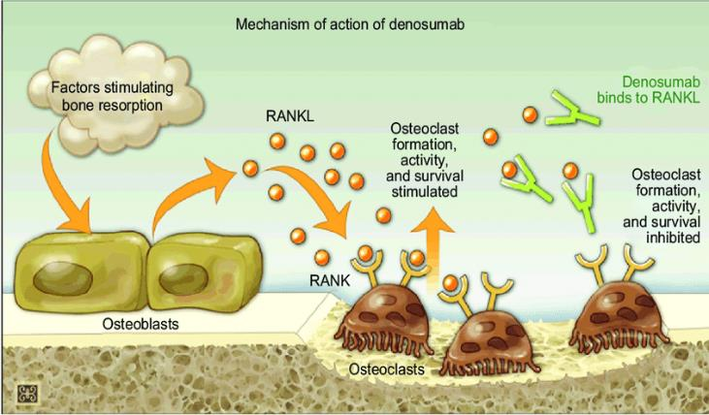
MOA
Denosumab is a monoclonal antibody that is fully human and was approved by the FDA as the first RANKL inhibitor.
RANK is activated by the ligand RANKL, which is present on the cell surface of osteoblasts.
By activating RANK, RANKL promotes the development of pre-osteoclasts into active osteoclasts.
Denosumab binds to RANKL and inhibits it, inhibiting the formation of osteoclasts.
This reaction protects the bone from resorption by mimicking the natural activity of OPG.

Slide 55
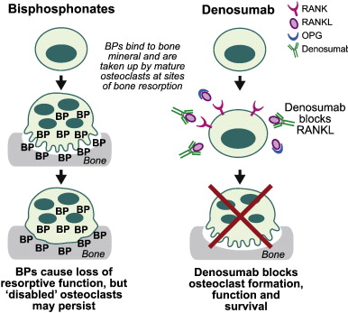
MOA for Denosumab and bisphosphonates
Denosumab is a more potent bone resorption inhibitor than BP.
When Denosumab medication is stopped, the suppression of bone turnover is quick and completely reversed.
Denosumab prevents RANKL from binding to its receptor, RANK, thereby inhibiting the development, activation, and survival of osteoclasts.
This is different from the mechanism of action of bisphosphonates, which bind to bone mineral and probably inhibit osteoclast function mainly by being taken up by osteoclasts at sites of bone resorption
R. Baron et al. / Bone 48 (2011) 677–692

Slide 56
Key differences between and bisphosphonates and denosumab
FEATURE | BISPHOSPHONATES | DEBRUMAB
Effect on osteoclast¹ | Induce apoptosis; | Inhibits osteoclast formation, function, and survival rapid onset of action
Nephrotoxicity | IV bisphosphonates have a higher risk of side effects than oral bisphosphonates, including nephrotoxicity | Denosumab does not cause nephrotoxicity.
Dose Adjustment (Renal Patients) | Required | No dose adjustment is necessary in patients
Pill Esophagitis | Oral bisphosphonates should be avoided in patients with esophageal emptying disorders or who are unable to sit upright, because these patients are at high risk for pill esophagitis | No such Disorder
Acute Phase Response | Seen almost 3 times more frequently with intravenous bisphosphonates than with denosumab. | Seen 3 times less frequently with denosumab compared to bisphosphonates.
Dosing | Once Daily , Once weekly (oral) | Once every 6th Month (Injection)
Int J Clin Pract. 2012 Dec; 66(12): 1139–1146.

Slide 57
Key differences between and bisphosphonates and denosumab
FEATURE | BISPHOSPHONATES | DEBRUMAB
First Pass Effect | Undergoes First pass metabolism | Subcutaneous injection. Does not undergo first-pass metabolism²
Pill Burden | Increased pill Burden | Reduced Pill Burden
Onset Of Action | Depends on Types of bisphosphonates and length of Treatment | Rapid Onset Of Action
Adherence¹ | Counsel on adherence Consider difficulties around dosing: - Must be taken with 6–8 oz plain water at least 30 minutes before first food/drink/ medication\ - Potential for esophagitis - Calcium supplements/antacids can interfere with absorption | No Counsel on Adherence required
First Pass Metabolism | As Oral Drug It undergoes First Pass metabolism | As a subcutaneous injection, does not undergo first-pass metabolism
1. JNCCN—Journal of the National Comprehensive Cancer Network | Volume 11 Supplement 3 | August 2013
2. Turner PV, Brabb T, Pekow C, Vasbinder MA. Administration of substances to laboratory animals: routes of administration and factors to consider. J Am Assoc Lab Anim Sci. 2011;50:600–613

Slide 58
What makes Denosumab different?
CATEGORY | FEATURES | DETAILS
In solid tumors with bone metastases | Demonstrated superiority vs ZA in delaying bone complications† in solid tumors with bone metastases ^{2,3}
 | NCCN Clinical Practice Guidelines (NCCN Guidelines®) recommend denosumab (Denosumab Q4W) for preventing bone complications in patients with bone metastases from solid tumors (prostate & breast Cancer) | Category 1‡ Preferred in men with prostate cancer and bone metastases ⁴ Category 1‡ in women with breast cancer and bone metastases ⁵
2. Denosumab (denosumab) prescribing information
3. Eur J Cancer. 2012;48(16):3082-3092.
4. NCCN Guidelines for Prostate Cancer V.2.2021
5. NCCN Guidelines for Breast Cancer V.6.2021

Slide 59
What makes Denosumab different Contd…?
CATEGORY | FEATURES | DETAILS
In solid tumors with bone metastases and multiple myeloma | The first and only BTA administered subcutaneously ^{2,6} | Convenient subcutaneous administration that may complement a patient’s primary treatment regimen
 | No need to adjust dosing for renal function | Denosumab is a monoclonal antibody and is not cleared by the kidneys The risk of hypocalcemia increases with decreasing renal function In patients with renal impairment, closely monitor calcium levels and calcium and vitamin D intake
 | Denosumab is a targeted therapy that works differently than ZA ^{2,3} | Denosumab is not a bisphosphonate. It is the only BTA that blocks the function of RANKL, an important target in the cycle of bone resorption
2. Denosumab (denosumab) prescribing information
3. Eur J Cancer. 2012;48(16):3082-3092.
6. ZOMETA® (zoledronic acid) prescribing information,

Slide 60
What makes Denosumab different Contd…?
CATEGORY | FEATURES | DETAILS
In solid tumors with bone metastases and multiple myeloma | No infusion chair | Most patients receive either an oral or SC treatment for their primary therapy ³ Denosumab is a SC injection administered half yearly (60mg) and once every 4 weeks (120mg) ¹ The mean elimination half-life of Denosumab was 28 days
1. Data on file, Amgen; 2020.
3. Eur J Cancer. 2012;48(16):3082-3092

Slide 61
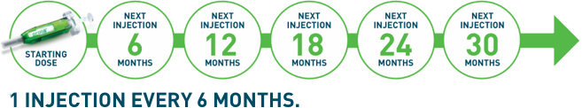
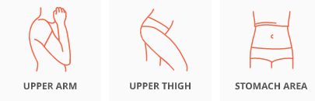
Dosage Form
60 mg/mL solution in a single-dose prefilled syringe.
+ Calcium 1000 mg daily and at least 400 IU vitamin D daily
Administered as 1 shot every 6 months¹
60 mg subcutaneous injection in the upper arm, upper thigh, or abdomen
FDA Access Sheet

Slide 62
Dosage
INDICATION | DOSAGE (with calcium 1000 mg/day and at least 400 IU vitamin D daily)
Aromatase Inhibitor Induced Bone Loss for breast cancer | 60 mg every 6 months as a subcutaneous injection
Androgen Deprivation Induced Bone Loss in prostate cancer | 60 mg every 6 months as a subcutaneous injection
Multiple Myeloma And Bone Metastasis From Solid Tumors | 120 mg as a subcutaneous injection every 4 weeks
Giant cell tumor of the bone | 120 mg every 4 weeks , with additional 120 mg doses on Days 8 and 15 of the first month of therapy.
Hypercalcemia of malignancy refractory to bisphosphonate therapy | 120 mg every 4 weeks , with additional 120 mg doses on Days 8 and 15 of the first month of therapy
FDA Access Sheet

Slide 63
Dosing
120 mg every 4 weeks as a subcutaneous injection in the upper arm, upper thigh, or abdomen
No dose adjustment is necessary in patients with renal impairment, but Calcium & D3 Monitoring is must in severe Renal impairment
FDA Access Sheet

Slide 64
Dosage
Pre-existing hypocalcemia must be corrected prior to initiating therapy with Denosumab
Adequately supplement all patients with calcium and vitamin D
Multiple vertebral fractures have been reported following Denosumab discontinuation
As a subcutaneous injection, Denosumab does not undergo first-pass metabolism¹
May lessen patient pill burden
denosumab) prescribing information, Amgen.

Slide 65
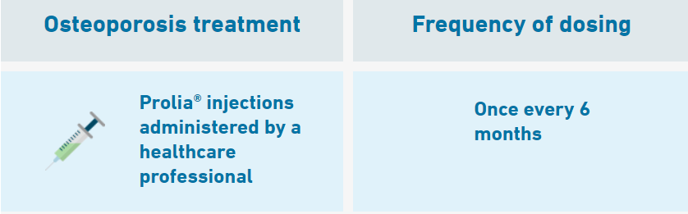
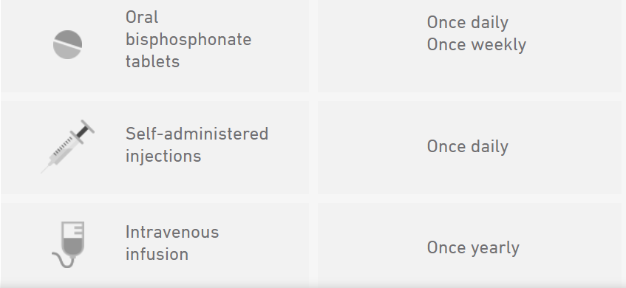
Dosing Benefit: Denosumab requires fewer doses than most other osteoporosis treatments indicated for men
Dose Adjustment:
No dose adjustment is necessary in patients with renal impairment, Patients.
However Calcium & D3 Monitoring is must in severe Renal impairment
Denosumab Inj is
Data on file, Amgen; 2020.

Slide 66




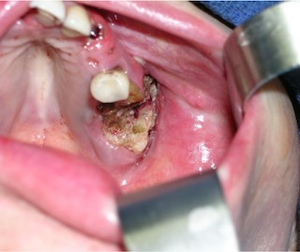
Information Essential To Safe Dosing Or Administration
BEFORE ADMINISTATION
AFTER ADMINISTATION
Calcium level check
Dental evaluation
Set up routine appointments
Take calcium and vitamin D supplements for extra prevention
https://www.Denosumab.com/start-treatment#Getting-Started

Slide 67
Contraindications
Hypocalcemia: Pre-existing hypocalcemia must be corrected prior to initiating therapy with Denosumab
Hypersensitivity: Denosumab is contraindicated in patients with a history of systemic hypersensitivity to any component of the product.
Reactions have included
Anaphylaxis
Facial swelling, and
Urticaria

Slide 68
Adverse Reaction:
The following serious adverse reactions are discussed below and also elsewhere in the labelling:
Hypocalcemia
Serious Infections
Dermatologic Adverse Reactions
Osteonecrosis of the Jaw
Multiple Vertebral Fractures (MVF) Following Discontinuation of Denosumab Treatment

Slide 69
Use in specific populations
Pregnancy: Based on animal data, may cause fetal harm.
Nursing mothers: May impair mammary gland development and lactation. Discontinue drug or nursing
Pediatric patients: Safety and efficacy not established
Renal impairment: No dose adjustment is necessary in patients with renal impairment. Patients with creatinine clearance < 30 mL/min or receiving dialysis are at risk for hypocalcemia. Supplement with calcium and vitamin D and consider monitoring serum calcium

Slide 70
Overdosage.
There is no experience with overdosage with Denosumab .

Slide 71
Summary
Indication:
Prevention of SRE’s secondary to multiple myeloma or bone metastases from solid tumors.
Giant cell tumor of the bone.
Hypercalcemia of malignancy.
Indicated for treating androgen deprivation-induced bone loss and aromatase inhibitor-induced bone loss.

Slide 72
Summary
MOA: RankL inhibitor
Dosage: 60mg/ml q6months and 120mg/ml q4weeks (with 1000mg Calcium & 400 IU Vit D3)
Contraindication: Hypocalcemia & Hypersensitivity
Adverse Reaction: Hypocalcemia_ Serious Infections_ Dermatologic Adverse Reactions _ Osteonecrosis of the Jaw_ Multiple Vertebral Fractures (MVF) Following Discontinuation of Denosumab Treatment
Special Population: Pregnancy, Nursing Mother not indicated, Renal patients_ No Dose Adjustment

Slide 73
Section 5: Guidelines & Recommendations

Slide 74
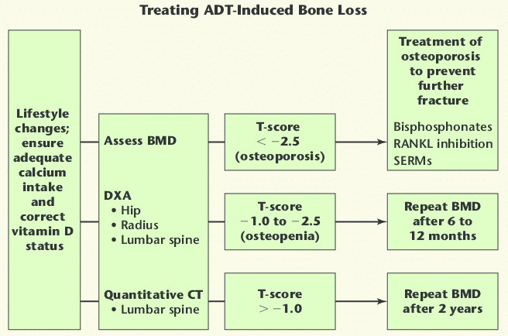
Treatment Algorithm: ADT Induced Bone Loss
Denosumab
VOL. 9 NO. 4 2007 REVIEWS IN UROLOGY

Slide 75
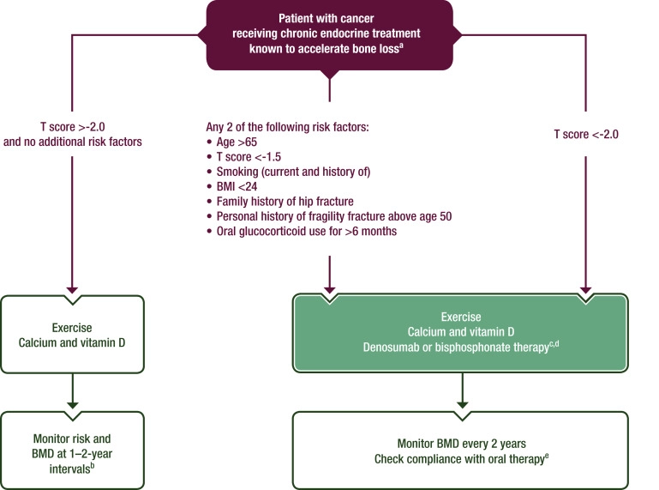

Treatment Algorithm: Endocrine Treatment Induced Bone Loss
Denosumab
ESMO Guidelines Committee

Slide 76
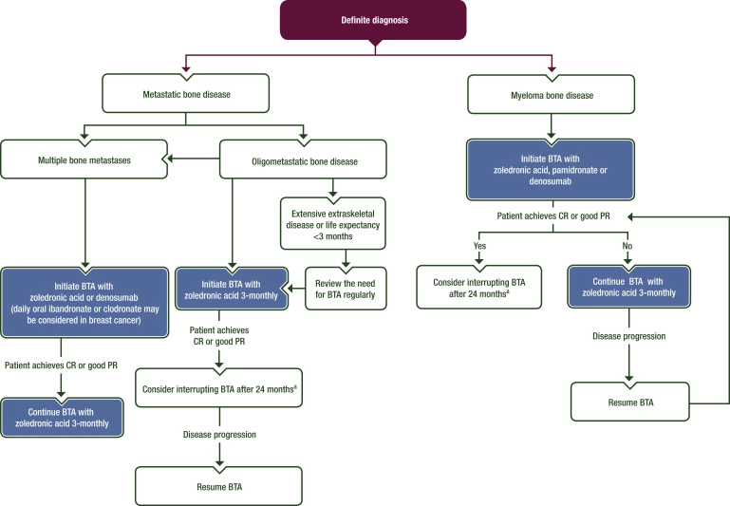
Treatment Algorithm: Solid Tumors & Multiple Myeloma
Denosumab
Denosumab

Slide 77
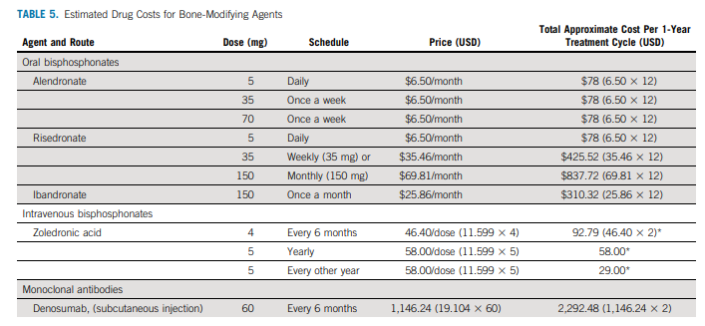
Estimated Drug cost for Bone Modifying Agents

Slide 78
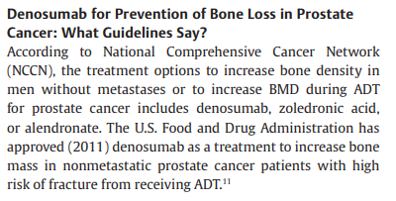


Indian Journal of Medical and Paediatric Oncology Vol. 42 No. 3/2021

Slide 79

Screening Guidelines
Indian Journal of Medical and Paediatric Oncology Vol. 42 No. 3/2021

Slide 80



Guidelines : Prostate Cancer patients: Non Metastatic & Metastatic Condition
Denosumab

Slide 81


Slide 82



Guidelines : Prostate Cancer

Slide 83


Guidelines : Breast cancer
Denosumab

Slide 84

Summary of Guidelines for BTA use.
BREAST CANCER
Journal of Bone Oncology, Volume 33, April 2022, 100416

Slide 85


Summary of Guidelines for BTA use.
PROSTATE CANCER
Journal of Bone Oncology, Volume 33, April 2022, 100416

Slide 86

Summary of Guidelines for BTA use.
SOLID TUMORS
Journal of Bone Oncology, Volume 33, April 2022, 100416

Slide 87

Summary of Guidelines for BTA use.
MULTIPLE MYELOMA
Journal of Bone Oncology, Volume 33, April 2022, 100416

Slide 88

Summary of Guidelines for BTA use.
MULTIPLE MYELOMA
Journal of Bone Oncology, Volume 33, April 2022, 100416

Slide 89
Section 6: Key Trials

Slide 90

1

Slide 91

Study Design
Randomized, multinational, double-blind, phase 3 study assessing the effects of Denosumab vs placebo on BMD and new vertebral fractures
Denosumab
1. Denosumab® (denosumab) prescribing information
5. N Engl J Med. 2009;361:745-755.
6. Lancet. 2015;386(9992):433-443.

Slide 92
Inclusion Criteria:
Men were stratified according to
Duration of androgen-deprivation therapy (ADT) ( 6 months or > 6 months) and
Age ( 70 years or < 70 years).
Men less than 70 years of age had either a
BMD T-score at the lumbar spine, total hip, or femoral neck between –1.0 and –4.0, or
A history of an osteoporotic fracture.
Patients were instructed to take
1000 mg of calcium and
400 IU of vitamin D supplementation daily.
1. Denosumab® (denosumab) prescribing information
5. N Engl J Med. 2009;361:745-755.
6. Lancet. 2015;386(9992):433-443.

Slide 93
Endpoints
Primary Endpoint:
Percent change in: Lumbar spine BMD from baseline to 24 months
Secondary Endpoints:
Incidence of: Newly diagnosed vertebral fracture through 36 months
Percent change in:
Lumbar spine BMD from baseline to 36 months
Total hip BMD from baseline to 36 months
Femoral neck BMD from baseline to 36 months
1. Denosumab® (denosumab) prescribing information
5. N Engl J Med. 2009;361:745-755.
6. Lancet. 2015;386(9992):433-443.

Slide 94

Efficacy: At 24 Month A significant increase in BMD at the lumbar spine compared with placebo (p < 0.0001; Primary Endpoint)
At 24 months, bone mineral density of the lumbar spine had increased by 5.6% in the Denosumab group as compared with a loss of 1.0% in the placebo group
The Bone Mineral Density At The Lumbar Spine Was Increased By
Mean percent change in BMD at 24 months
Denosumab
1. Denosumab® (denosumab) prescribing information
5. N Engl J Med. 2009;361:745-755.
6. Lancet. 2015;386(9992):433-443.

Slide 95

Efficacy: At 36 Months Denosumab demonstrated a continued increase in BMD through 36 months (Secondary Endpoint)
LUMBAR SPINE
Mean percent change in BMD at 36 months
1. Denosumab® (denosumab) prescribing information
5. N Engl J Med. 2009;361:745-755.
6. Lancet. 2015;386(9992):433-443.

Slide 96

Efficacy: At 36 Months Denosumab demonstrated a continued increase in BMD through 36 months (Secondary Endpoint)
TOTAL HIP
Mean percent change in BMD at 36 months
1. Denosumab® (denosumab) prescribing information
5. N Engl J Med. 2009;361:745-755.
6. Lancet. 2015;386(9992):433-443.

Slide 97

Efficacy: At 36 Months Denosumab demonstrated a continued increase in BMD through 36 months (Secondary Endpoint)
FEMORAL NECK
Mean percent change in BMD at 36 Months
1. Denosumab® (denosumab) prescribing information
5. N Engl J Med. 2009;361:745-755.
6. Lancet. 2015;386(9992):433-443.

Slide 98

New Fracture: Denosumab sustained reduction of new vertebral fractures up to 36 months ⁶
Denosumab significantly decreased the incidence of new vertebral fractures up to 36 months ^{1,6}
Relative risk reduction of new vertebral fracture at 12, 24, and 36 months ^{1,5}
62% Relative Risk Reduction in the incidence of new vertebral fractures at 36 months* ¹
ARR = Absolute Risk Reduction.
1. Denosumab® (denosumab) prescribing information
5. N Engl J Med. 2009;361:745-755.
6. Lancet. 2015;386(9992):433-443.

Slide 99
Safety And Tolerability
Adverse Events (10% Frequency In Each Treatment Group)¹
 | Placebo (n = 725) | Denosumab (n = 731)
Arthralgia | 11.0% | 12.6%
Back pain | 10.2% | 11.1%
Constipation | 10.3% | 10.0%
Denosumab has been studied in a clinical trial of 1468 men with prostate cancer on ADT.⁵
The overall incidence of adverse events was similar between Denosumab and placebo (both approximately 87%).⁵
1. Denosumab® (denosumab) prescribing information
5. N Engl J Med. 2009;361:745-755

Slide 100
Safety And Tolerability
Pain in extremity and musculoskeletal pain have also been reported in clinical trials¹
The percentage of patients who withdrew from the study due to adverse events :
7.0% and 6.1% for the Denosumab and placebo groups, respectively¹
Overall rates of serious adverse events
34.6% and 30.6%, between Denosumab and placebo respectively¹
1. Denosumab® (denosumab) prescribing information
5. N Engl J Med. 2009;361:745-755

Slide 101

2

Slide 102
Phase 3, double-blind, double-dummy, active-controlled trials in patients with bone metastases from solid tumors (Denosumab ®: n=2,862; ZA: n=2,861)
Intervention: Patients were randomized 1:1 to receive Denosumab 120 mg SC Q4W or ZA 4 mg IV Q4W
Per label, ZA was dose-adjusted for baseline creatinine clearance ≤60 mL/min
No dose adjustments were made and no doses were withheld for increased serum creatinine for Denosumab
2. Eur J Cancer. 2012;48(16):3082-3092.

Slide 103

Endpoints & Demographics
Primary Endpoints: Time to first bone complication as compared with ZA
Secondary Endpoint : Time to first bone complication (superiority)

Slide 104

Study Schema
Evaluated in 3 identically designed head-to-head studies vs ZA + 2-year OLE phase ^{2,3}
OLE, open-label extension
2. Eur J Cancer. 2012;48(16):3082-3092.
3. Support Care Cancer. 2016;24(1):447-455.

Slide 105

Result: SRE Prevention
Denosumab was superior to zoledronic acid in delaying time to first on-study SRE by a median 8.21 months,
Denosumab was superior to zoledronic acid in preventing SRE with favourable safety and convenience in patients with bone metastases from advanced cancer.
2. Eur J Cancer. 2012;48(16):3082-3092.

Slide 106

3

Slide 107
Aim
This pre-planned analysis evaluates the efficacy and safety of denosumab versus zoledronic acid across three pivotal studies.
2. Eur J Cancer. 2012;48(16):3082-3092.

Slide 108
Aim
To compare studies of men with prostate cancer receiving ADT and women with breast cancer following adjuvant endocrine therapy in order to evaluate the effects of Denosumab in terms of
BMD increase at 24 and 36 months,
The BMD loss,
The reduction of fractures risk (in particular vertebral fractures) at 24 and 36 months and
Safety (overall, serious adverse events – SAEs and discontinuation rate).
J Bone Oncol. 2019 Oct; 18: 100252.

Slide 109
Study Design
RCT’s included: 3
Trials with sample size more than 10
Prostate cancer patients
Patients were treated with ADT
Denosumab at the dose of 60 mg every six month or placebo.
J Bone Oncol. 2019 Oct; 18: 100252.

Slide 110
Result
Reduction of the BMD loss up to 36 months both at the lumbar and femoral level
BMD increase both at 24 and 36 months.
Reduction in the number of new vertebral and femoral fractures at 24 and 36 months.
Denosumab did not affect both the SAEs and therapy discontinuation risk.
J Bone Oncol. 2019 Oct; 18: 100252.

Slide 111
Conclusion
Denosumab administration can be considered effective and safe in the prevention and management of the above mentioned adverse events related to hormonal therapies designed for breast and prostate tumours.
J Bone Oncol. 2019 Oct; 18: 100252.

Slide 112

4

Slide 113

RESULT
Breast cancer with bone metastases
Journal of Clinical Oncology 28, no. 35 (December 10, 2010) 5132-5139

Slide 114

Result
Denosumab was superior to zoledronic acid in delaying or preventing SREs in patients with breast cancer metastatic to bone and was generally well tolerated.
With the convenience of a subcutaneous injection and no requirement for renal monitoring, denosumab represents a potential treatment option for patients with bone metastases

Slide 115

5

Slide 116

RESULT
Prostate cancer with bone metastases
Lancet. 2011;377(9768):813-822

Slide 117

Result
Denosumab was better than zoledronic acid for prevention of skeletal-related events, and potentially represents a novel treatment option in men with bone metastases from castration-resistant prostate cancer.
Lancet. 2011;377(9768):813-822

Slide 118

5

Slide 119

RESULT
Bone Pain
Cancer. 2013;119(4):832-838.

Slide 120

6

Slide 121

Denosumab was studied in a broad range of newly diagnosed patients¹
Lancet Oncol. 2018;19(3):370-381.

Slide 122
Intervention
In this 4-year, phase 3 study, patients were randomized 1:1 to receive
Either Denosumab 120 mg by SC injection Q4W and a placebo by IV infusion (n=859) or
ZA 4 mg by IV infusion over 15 minutes, Q4W, and a placebo by SC injection (n=859).
Both arms received daily supplements of calcium and vitamin D. ^{1-3,‡}
Lancet Oncol. 2018;19(3):370-381.

Slide 123
No SC dose adjustments were required for administering Denosumab ¹
ZA was dose adjusted for baseline creatinine clearance and subsequent dose intervals were determined by serum creatinine levels 2,4
Patients with creatinine clearance <30 mL/min were not included in the clinical trial¹
Primary endpoint: Time to first on-study bone complication (noninferiority analysis).¹
Lancet Oncol. 2018;19(3):370-381.

Slide 124

Study Design
Evaluated in a phase 3 head-to-head study vs ZA + 2-year OLE phase ^{2,3}
Lancet Oncol. 2018;19(3):370-381.

Slide 125

XGEVA® provided nearly 23 months of prevention ^{1,2}
Lancet Oncol. 2018;19(3):370-381.

Slide 126
Summary
TRIAL | PUBLICATION & YEAR | AUTHOR | INDICATION | RESULT | CONCLUSION
Denosumab in men receiving Androgen deprivation therapy for prostate cancer | N Engl J Med. 2009;361:745-755. | Matthew R. Smith et.al | for bone health in prostate and breast cancer patients receiving endocrine therapy (Solid Tumors) | At 24 months, BMD of the LS had increased by 5.6%. Decreased incidence of new vertebral fractures at 36 months with Denosumab. | Denosumab was associated with increased bone mineral density at all sites and a reduction in the incidence of new vertebral fractures among men receiving ADT
Superiority of denosumab to zoledronic acid for prevention of skeletal-related events: a combined analysis of 3 pivotal, randomised, phase 3 trials | Eur J Cancer .2012Nov;48(16): 3082-92 | Allan Lipton , et.al | prevention of skeletal-related events In Solid Tumors | Denosumab was superior to zoledronic acid in delaying time to first on-study SRE by a median 8.21 months, | Denosumab was superior to zoledronic acid in preventing SRE with favourable safety and convenience in patients with bone metastases from advanced cancer.
Lancet Oncol. 2018;19(3):370-381

Slide 127
Summary
TRIAL | PUBLICATION & YEAR | AUTHOR | INDICATION | RESULT | CONCLUSION
Denosumab for bone health in prostate and breast cancer patients receiving endocrine therapy? A systematic review and a meta-analysis of randomized trials | J Bone Oncol. 2019 Oct; 18: 100252. | Antonio Galvano et.al | Osteoporosis in men receiving Androgen deprivation therapy for Non Metastatic prostate cancer | Reduction of the BMD loss up to 36 months both at the lumbar and femoral level BMD increase both at 24 and 36 months. Reduction in the number of new vertebral and femoral fractures at 24 and 36 months. Denosumab did not affect both the SAEs and therapy discontinuation risk. | Denosumab administration can be considered effective and safe in the prevention and management of the above mentioned adverse events related to hormonal therapies designed for breast and prostate tumours
Denosumab compared with zoledronic acid for the treatment of bone metastases in patients with advanced breast cancer: a randomized, double-blind study | J Clin Oncol . 2010 Dec 10;28(35):5132-9. | Alison T Stopeck, et.al | prevention of skeletal-related events In Solid Tumors | Approx 60 % of Patients on Denosumab does not have complication at 27 month | Denosumab was better than zoledronic acid for prevention of skeletal-related events, and potentially represents a novel treatment option in men with bone metastases from castration-resistant prostate cancer.
Lancet Oncol. 2018;19(3):370-381

Slide 128
Summary
TRIAL | PUBLICATION & YEAR | AUTHOR | INDICATION | RESULT | CONCLUSION
Denosumab versus zoledronic acid for treatment of bone metastases in men with castration-resistant prostate cancer: a randomised, double-blind study | Lancet . 2011 Mar 5;377(9768):813-22. | Karim Fizazi. et.al | bone metastases in men with castration-resistant prostate cancer: | Prevented bone complications for a median of 20.7 months | Denosumab was better than zoledronic acid for prevention of skeletal-related events, and potentially represents a novel treatment option in men with bone metastases from castration-resistant prostate cancer
Pain outcomes in patients with advanced breast cancer and bone metastases: results from a randomized, double-blind study of denosumab and zoledronic acid | Cancer . 2013 Feb 15;119(4):832-8. | Charles S Cleeland, et.al | Advanced breast cancer and bone metastases | Results for castration-resistant prostate cancer patients†: XGEVA® (5.8 months) vs ZA (4.9 months) 12 Results for advanced solid tumor-only cancer patients (excluding multiple myeloma)†: XGEVA® (4.7 months) vs ZA (3.7 months) | Denosumab demonstrated improved pain prevention and comparable pain palliation compared with ZA. In addition, fewer denosumab-treated patients shifted to strong opioid analgesic use.
Lancet Oncol. 2018;19(3):370-381

Slide 129
Summary
TRIAL | PUBLICATION & YEAR | AUTHOR | INDICATION | RESULT | CONCLUSION
Denosumab versus zoledronic acid in bone disease treatment of newly diagnosed multiple myeloma: an international, double-blind, double-dummy, randomised, controlled, phase 3 study | Lancet Oncol. 2018;19(3):370-381. | Raje N. et.al | bone Diseases with multiple Myeloma | XGEVA® provided nearly 23 months of prevention | Efficacy and safety outcomes from this Asian subgroup were comparable to those of the full study population. Overall, this analysis supports denosumab as an additional treatment option for standard of care for Asian patients with newly diagnosed MM with lytic bone lesions.
Lancet Oncol. 2018;19(3):370-381

Slide 130
Section 7: FAQ

Slide 131
Is Denosumab a chemotherapy drug?
No. Denosumab is not a chemotherapy drug.
It is a targeted treatment, called a monoclonal antibody and is classified as a bone-modifying agent.
Although it is not a chemotherapy drug it is often given with chemotherapy medicines.

Slide 132
Does Denosumab increase bone density in Patients with Prostate Cancer?
Yes, denosumab does increase bone density.
Denosumab significantly increased BMD at all clinical sites measured, relative to treatment with placebo at 3 years:
7.9% at the lumbar spine, 5.7% at the total hip, 4.9% at the femoral neck, 6.9% at the hip trochanter, 6.9% at the distal 1/3 radius and 4.7% at the total body (all p < 0.0001).
In a prospectively planned exploratory analysis, significant increases in BMD were observed at the lumbar spine, total hip, femoral neck and the hip trochanter 1 month after the initial dose

Slide 133
Does Denosumab increase the risk of new Fracture in Patients with Prostate Cancer?
NO. reversely Denosumab demonstrated a significant relative risk reduction of new vertebral fractures:
85% (1.6% absolute risk reduction) at 1 year,
69% (2.2% absolute risk reduction) at 2 years and
62% (2.4% absolute risk reduction) at 3 years (all p < 0.01).

Slide 134
How long should you take Denosumab for?
Denosumab is meant to be taken long-term.
Efficacy and safety of Denosumab once every 6 months for 3 years were investigated in men with histologically confirmed non-metastatic prostate cancer receiving ADT
However, Denosumab should be discontinued if you experience intolerable side effects or serious side effects such as osteonecrosis of the jaw or osteomyelitis, or if Denosumab appears to be ineffective for you.
There have been reports of a higher risk of multiple vertebral fractures and hypercalcemia (high calcium levels) occurring within the first year following discontinuation of Denosumab.
Patients should be monitored for both conditions when Denosumab is stopped.

Slide 135
Does Denosumab weaken your immune system?
Yes, Denosumab (denosumab) does appear to weaken your immune system.
Research has shown people who take Denosumab are at an increased risk of serious infections leading to hospitalizations, including serious infections of the skin, abdominal, urinary tract, and ear.
People administered concomitant immunosuppressant agents (such as prednisone or cyclosporine) or with impaired immune systems may be at an even higher risk.
RANKL and RANK are also expressed in cells of the immune system, including activated T lymphocytes, B cells, and dendritic cells.
This implies that inhibition of RANKL by Denosumab might alter a person’s immune function and increase their susceptibility to infections.

Slide 136
Does Denosumab cause bone pain?
Denosumab may cause pain in the bones, muscles, and joints.
Pain in the bones, joints, or muscles may start soon after treatment or many months later, but usually in the first year of taking Denosumab.
This pain may be severe and decrease your quality of life or it may be mild and barely noticeable.
Research has shown that for most patients, Denosumab is more effective than zoledronic acid at extending the bone pain-free interval.
Overall across several different cancer types, Denosumab extended the pain-free interval by 1.8 months.

Slide 137
Does Denosumab cause low blood pressure?
Low blood pressure is not a common side effect of Denosumab;
However, it may occur in people who are allergic to Denosumab alongside other allergy symptoms such as facial and throat swelling and tightness, shortness of breath, and a rash.

Slide 138
Does Denosumab cause weight gain?
Denosumab has not been associated with weight gain in clinical studies.
In studies, peripheral edema (fluid retention in the areas like the arms or legs) was reported in 4.9% of patients compared to 4% receiving a placebo
Denosumab can cause peripheral edema (fluid retention) or swelling, and this may lead to weight gain in some people.

Slide 139
Summary
Denosumab
Is not a chemotherapy drug.
Increase bone density in prostate cancer patients with bone loss associated with ADT
Demonstrated a significant relative risk reduction of new vertebral fractures
Is meant to be taken long-term_ Efficacy and safety investigated for 3 years
Does appear to weaken immune system _ May increase susceptibility to infections.
Does not have effect on Blood pressure
Not been associated with weight gain

Slide 140
Thank you

